Slide 1
Nuclear Fuel Performance
NE 533: Spring 2023

Slide 2
Last Time
Developed analytical solutions for temperature profile
This time, we move from the analytical into the numerical framework
Parabolic profile of temperature in fuel
Cosine profile of LHR as a function of z on fuel rod

Slide 3
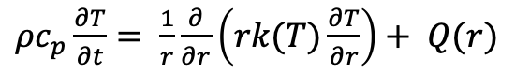

Review of Assumptions
Analytical solution requires:
Steady-state solution
Temperature is axisymmetric
T is constant in Z
Thermal conductivity is independent of temperature
Temperature profile in the fuel is parabolic, linear profiles in gap, clad and coolant
$ρc_{p}\frac{∂T}{∂t}= \frac{1}{r}\frac{∂}{∂r}\left(rk(T)\frac{∂T}{∂r}\right)+ \frac{∂}{∂z}\left(k(T)\frac{∂T}{∂z}\right)+Q(r,z)$
$ρc_{p}\frac{∂T}{∂t}= \frac{1}{r}\frac{∂}{∂r}\left(rk(T)\frac{∂T}{∂r}\right)+ Q(r)$

Slide 4
Thermal conductivity

Slide 5
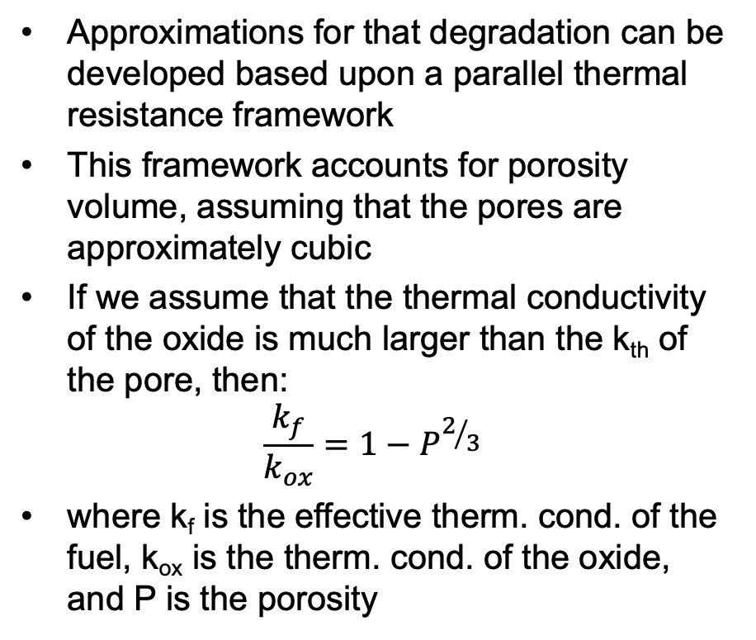
Thermal Conductivity
Knowledge of the thermal conductivity of the fuel, gap, and cladding is essential to determine the temperature distribution and transient thermal response
Sintering creates a porous oxide with about 95% theoretical density
The pores provide space to accommodate fission gases, and thus reduce swelling, but diminish the thermal conductivity
Additional porosity develops from fission gas accumulation
Porosity will degrade thermal conductivity
Approximations for that degradation can be developed based upon a parallel thermal resistance framework
This framework accounts for porosity volume, assuming that the pores are approximately cubic
If we assume that the thermal conductivity of the oxide is much larger than the k_{th} of the pore, then:
$$\frac{k_{f}}{k_{ox}}=1−P^{2/3}$$
where k_{f} is the effective therm. cond. of the fuel, k_{ox} is the therm. cond. of the oxide, and P is the porosity

Slide 6
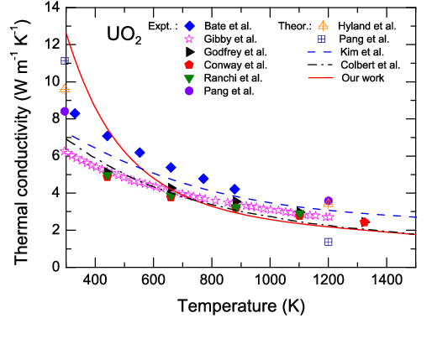
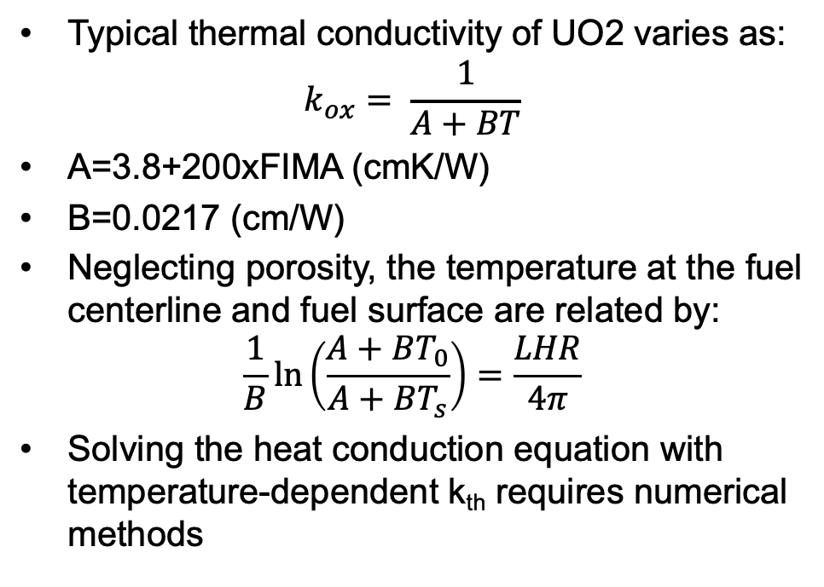
Thermal Conductivity
Typical thermal conductivity of UO2 varies as:
$$k_{ox}= \frac{1}{A+BT}$$
A=3.8+200xFIMA (cmK/W)
B=0.0217 (cm/W)
Neglecting porosity, the temperature at the fuel centerline and fuel surface are related by:
$$\frac{1}{B}\ln\left(\frac{A+BT_{0}}{A+BT_{s}}\right)=\frac{LHR}{4π}$$
Solving the heat conduction equation with temperature-dependent k_{th} requires numerical methods

Slide 7
Example

Slide 8
Operational Limits
Thermal limits are prescribed for normal operation and accident conditions, with the goal of avoiding fuel damage
Operational limits provide an envelope under which fuel failure will not occur
LHR limits
Centerline temperature limits
Pellet-Clad Mechanical Interaction Limits
will cover later in semester

Slide 9
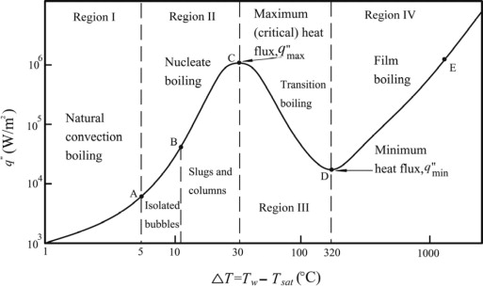
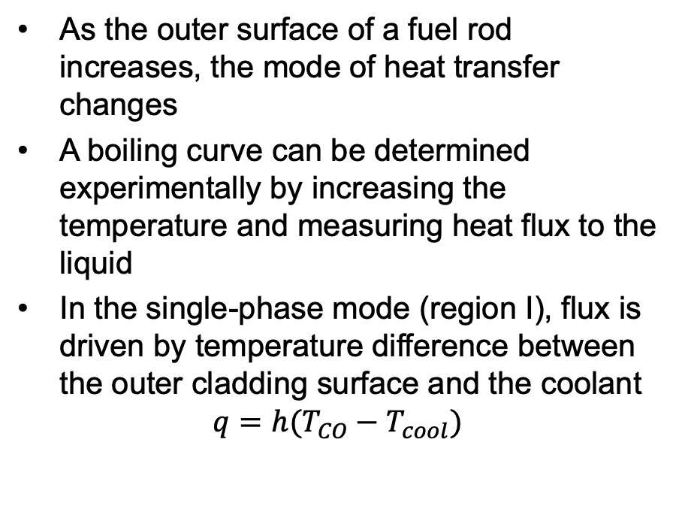
Critical Heat Flux
As the outer surface of a fuel rod increases, the mode of heat transfer changes
A boiling curve can be determined experimentally by increasing the temperature and measuring heat flux to the liquid
In the single-phase mode (region I), flux is driven by temperature difference between the outer cladding surface and the coolant
$$q=h(T_{CO}−T_{cool})$$

Slide 10
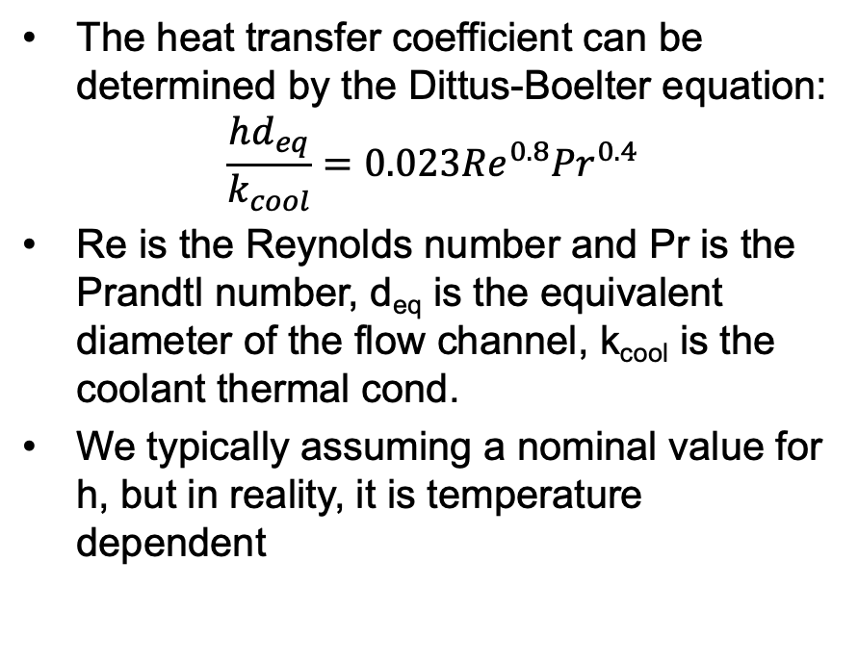
Critical Heat Flux
The heat transfer coefficient can be determined by the Dittus-Boelter equation:
$$\frac{hd_{eq}}{k_{cool}}=0.023{Re}^{0.8}{Pr}^{0.4}$$
Re is the Reynolds number and Pr is the Prandtl number, d_{eq} is the equivalent diameter of the flow channel, k_{cool} is the coolant thermal cond.
We typically assuming a nominal value for h, but in reality, it is temperature dependent

Slide 11
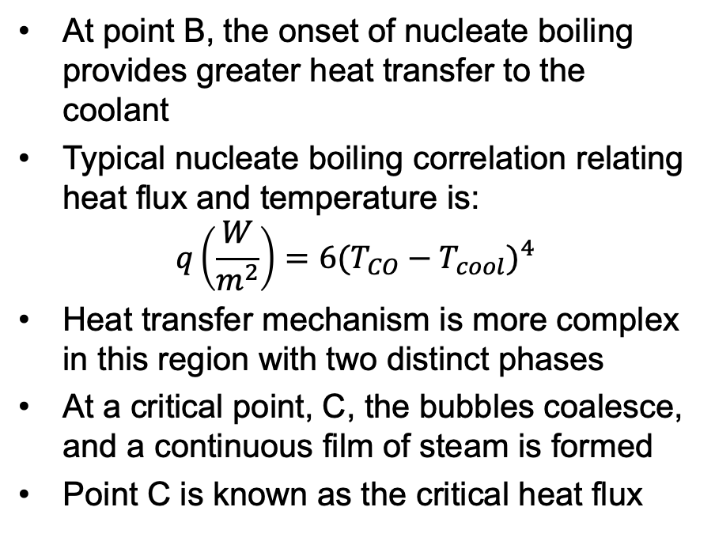
Critical Heat Flux
At point B, the onset of nucleate boiling provides greater heat transfer to the coolant
Typical nucleate boiling correlation relating heat flux and temperature is:
$$q\left(\frac{W}{m^{2}}\right)=6{(T_{CO}−T_{cool})}^{4}$$
Heat transfer mechanism is more complex in this region with two distinct phases
At a critical point, C, the bubbles coalesce, and a continuous film of steam is formed
Point C is known as the critical heat flux

Slide 12
Critical Heat Flux
Beyond point C the rod is ”coated” in steam and the heat flux is dramatically reduced
The heat transfer coefficient from cladding to steam is much lower than from cladding to water
T_{sat} is the saturation temperature, which is fixed for a given pressure, whereas the coolant temperature (T_{cool}) increases
Beyond point C, film boiling can occur

Slide 13
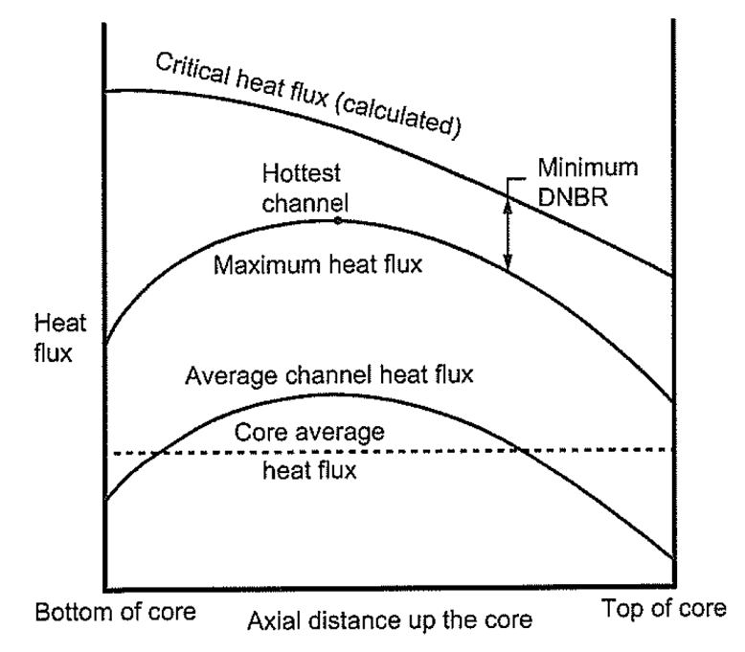
DNBR
The departure from nucleate boiling ratio (DBNR) is the ratio of the heat flux that causes dryout (the critical heat flux) to the actual heat flux
The limits on the DBNR in the hottest channel is 1.15 to 1.3, or a margin of 15-30 percent
The DNBR is determined by identifying the hottest channel, and the location where the heat flux most closely approaches the CHF
When CHF is reached, cladding temperature can increase to above 1100 K

Slide 14
Problem Session

